Slide 1
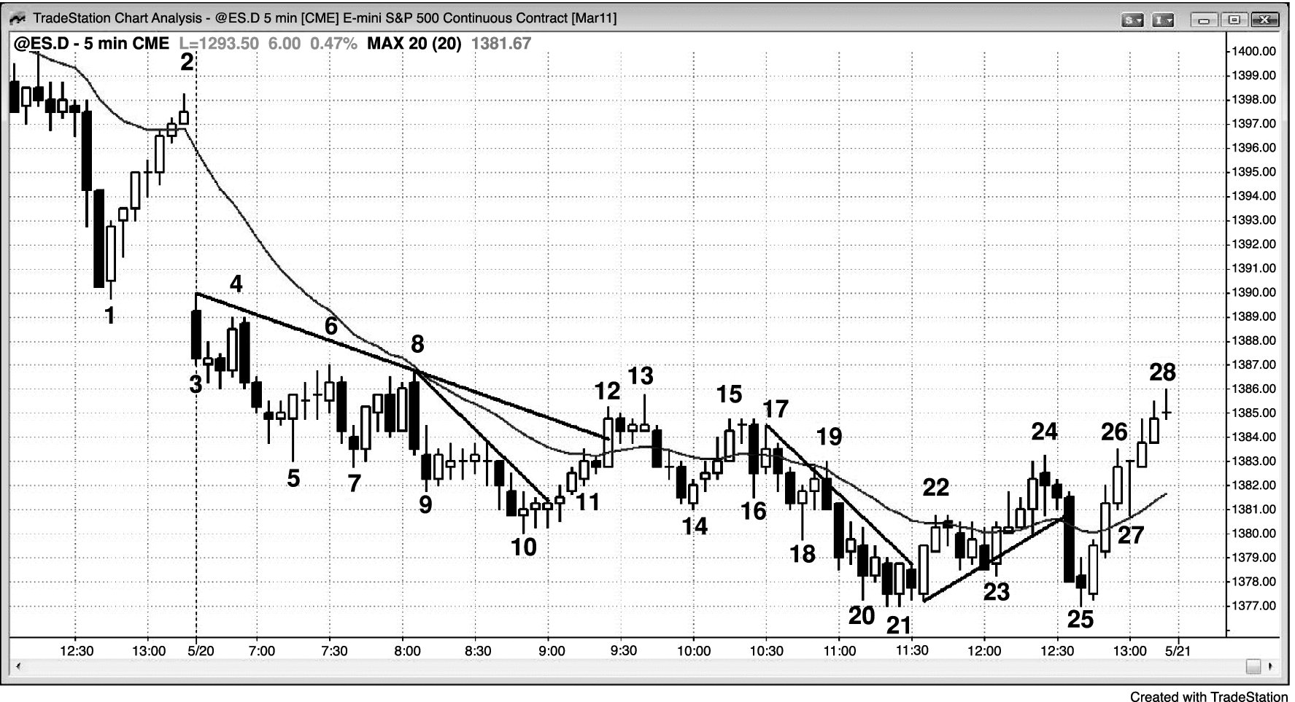
FIGURE 13.1 Twenty Gap Bars

Slide 2
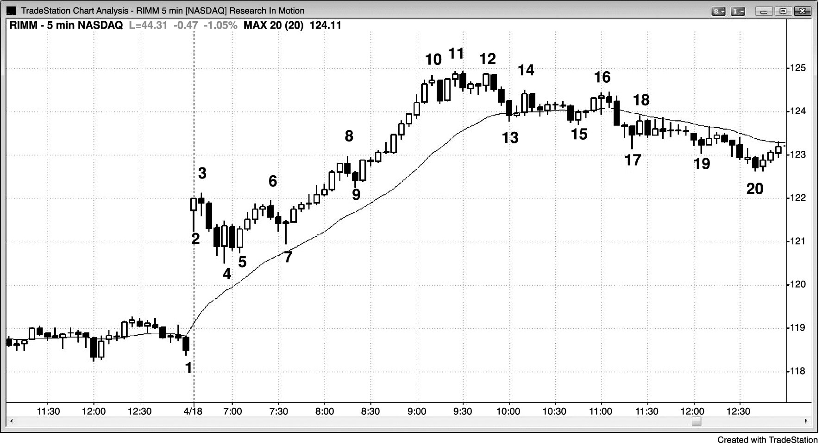
FIGURE 13.2 Twenty Gap Bars Are Not Always a Buy Setup

